Slide 1

Stock Closing Price Prediction Using Bayesian Analysis
Presented By:
Sohan Bachuwar (811236035)
Rohith Reddy Poreddy (811254545)
Sathwika Reddy Thipparthi (811255702)
Sai Vamsi Dudigam (811226902)
Venkata Raghava Sanjay Varma Dantuluri (811255424)

Slide 2
Introduction
This project focuses on stock market prediction, an important topic for financial experts and investors looking to estimate the future prices of stocks and other financial instruments traded on stock exchanges.
The main aim of this project is to use the ability of Bayesian analysis to estimate the closing values of stocks.
Bayesian analysis is a helpful and trustworthy technique in such a situation, succeeding in its ability to capture and measure the inherent uncertainty associated with parameter estimates and, as a result, in creating predictions.

Slide 3
Background
Time series data analysis involves the estimation of the number of past values that are valuable for predicting the current value.
Analysing these plots suggests that the previous day's value correlates significantly with the current day's estimation compared to other past values, indicating that a lag value of one is appropriate for closing price estimation.
This observation suggests that most of the time-varying components in the series are captured within a one-day lag, and the residual component is independent of time.

Slide 4
Problem Definition
A Structural Time Series model is utilized in this project, which is a flexible category of probabilistic models widely used for time-series research.
The STS model's main advantage is its capacity to break down observable time series data into discrete components, providing a more sophisticated understanding of the underlying patterns and dynamics and a general structural time series model can be written as:
y_{t} = μ_{t}+γ_{t}+ε _{t}

Slide 5
Problem Definition
The STS model consists of autoregression, which accounts for the influence of previous data points on current observations; moving averages, which ease out short-term fluctuations in the data; local linear trends, which obtain localized linear trends within the time series; seasonality, which identifies recurring patterns linked to specific time-related factors; and regression, which allows the incorporation of external variables that may affect the time series.

Slide 6
Dataset
The daily stock price data of Amazon for five years period starting from 1st January 2014 till 6th December 2019 is collected.
The data is gathered using the Pandas DataReader package's "get_data_yahoo" function, which obtains stock data from Yahoo Finance with an emphasis on daily closing prices.
The dataset is regarded as a time series, and time series analysis is used to break it down into three key components: trend, seasonality, and residual.

Slide 7
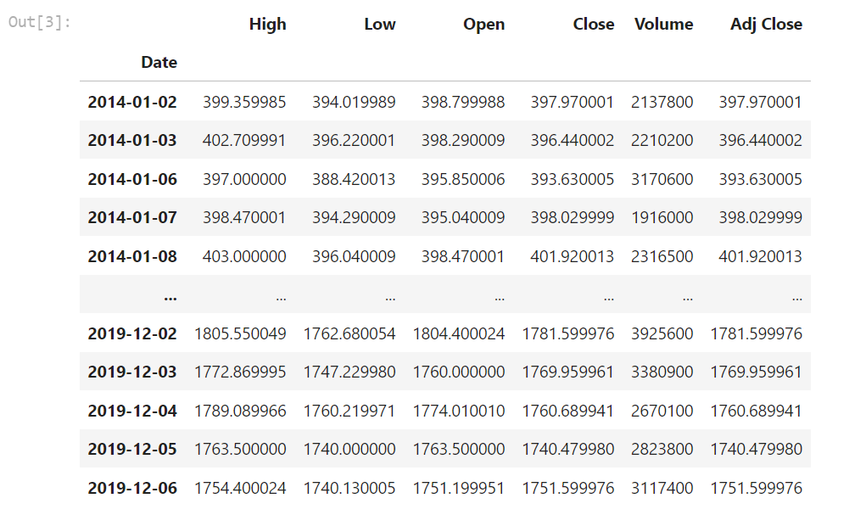
Sample

Slide 8
Description
Open is the price of the stock at the beginning of the trading day.
High is the highest price of the stock on that trading day.
Low is the lowest price of the stock on that trading day.
Close is the price of the stock at closing time.
Volume indicates how many stocks were traded.
Adj Close is the updated stock closing price that accurately reflects the stock's value after accounting for any corporate actions.

Slide 9
Data Analysis
Since the data being considered in this project is the daily closing price of stocks, it can be considered a time series. A time series can be decomposed into these 3 major components.
Trend - Trend tries to capture the slope of the series. It mimics the upward and downward slope of the observed values.
Seasonality - Seasonality is the constant factor present in the series which is repeated after certain interval of time.
Residual - Whatever part of the time series is left after removing trend and seasonality is the residual, which is basically random variation.

Slide 10
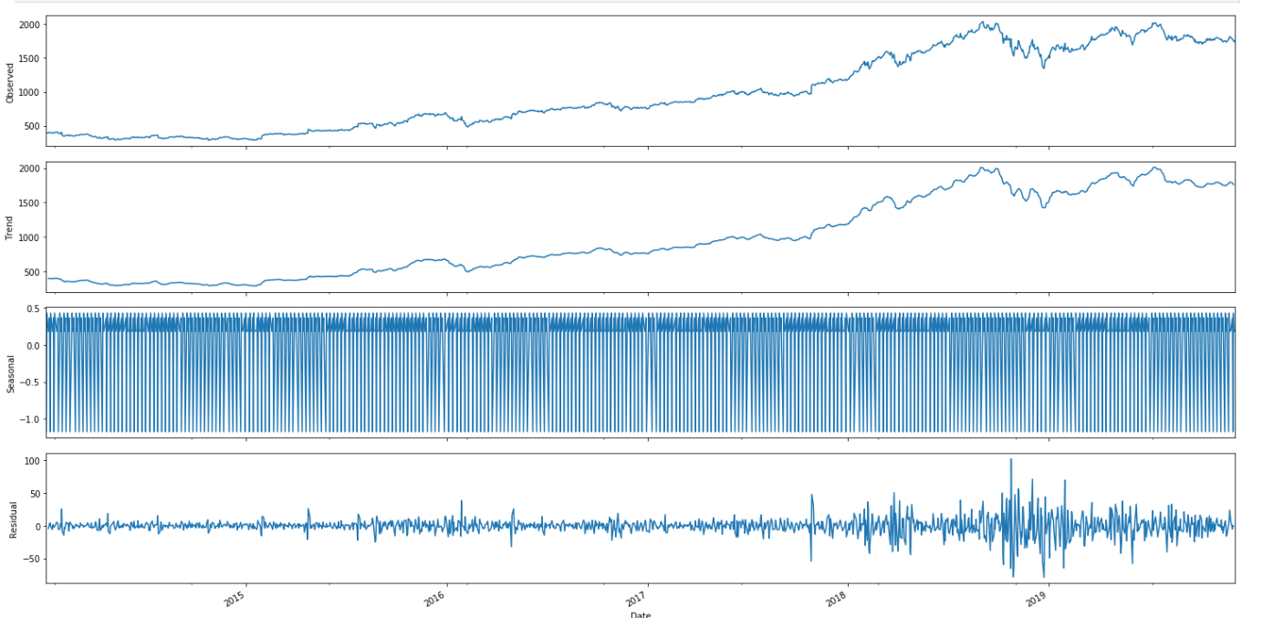

Slide 11
Approach
Structural time series are a family of probability models that include many standard time-series modeling ideas, such as autoregression, moving averages, local linear trends, seasonality, and regression.
The STS model built in this project expresses an observed time series as sum of following simpler components: The individual components are time series governed by a particular structural assumption.
One component encodes a day-of-week seasonal effect, another a local linear trend, and the third one is an autoregressive component to model any unexplained residual effects.
Notes:
Structural time series (STS) models constitute a family of probability models encompassing key time-series modeling concepts: autoregression, moving averages, local linear trends, seasonality, and regression. In this project, the STS model represents an observed time series as a sum of distinct components, each adhering to a specific structural assumption. These components include a day-of-week seasonal effect, capturing weekly patterns; a local linear trend, depicting gradual changes over time; and an autoregressive component, addressing unexplained residual effects in the time series. This comprehensive modeling approach allows for a nuanced understanding of diverse temporal patterns within the data.

Slide 12
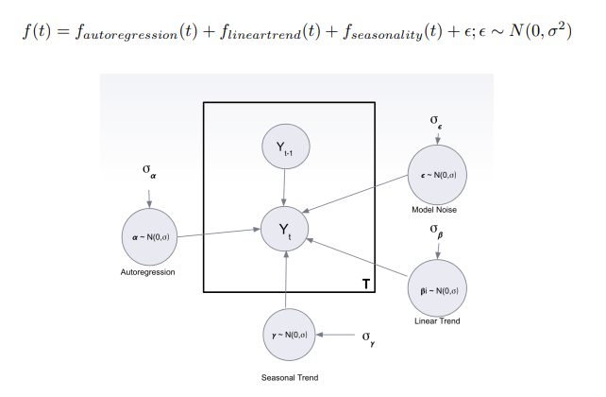
Notes:
-Yt is called observed time series
The image shows a diagram of a system with a number of circles. The text in the image describes a forecasting model, where f(t) is the forecast value at time t. The model is composed of four components:
Autoregression: This component models the relationship between the current forecast value and past forecast values.
Linear trend: This component models the overall trend in the data.
Seasonality: This component models the cyclical patterns in the data, such as daily, weekly, or monthly seasonality.
Noise: This component represents the random variation in the data that cannot be explained by the other components.
The diagram shows how the different components of the model interact with each other. The autoregression component is influenced by the previous forecast value, the linear trend component, and the seasonal trend component. The noise component is independent of all the other components.

Slide 13
α - coefficients for lagged features in Auto Regression Model
β - slope scale(β1), level scale(β2) are Linear Trend parameters
γ - drift scale is Seasonality parameter .
e - observation noise scale is model’s noise variance parameter.
The individual components are time series governed by a particular structural assumption. One component encodes a day-of-week seasonal effect, another a local linear trend, and the third one is an autoregressive component to model any unexplained residual effects.

Slide 14
The joint distribution of the parameters is decomposed into a product of the distribution of individual components. Q(z) = q(β1) · q(β2) · q(α) · q(γ) · q€) .
The distribution of the individual parameters is assumed to be normal with zero mean. Also, the priors used on the parameters are normal and the value of the priors is decided by the tensorflow probability library. A couple of different priors were tried based on heuristics and prior knowledge of the stock market but the default priors performed best for prediction.
A loss function was defined as negative of ELBO which was optimized using stochastic gradient optimization technique, Adam optimizer. After 50 iterations the algorithm converged and the distribution of the parameters was obtained.
Notes:
The joint distribution of the parameters is decomposed into a product of the distribution of individual components. Q(z) = q(β1) · q(β2) · q(α) · q(γ) · q€)
This means that the joint distribution of the parameters can be expressed as the product of the individual distributions of the parameters. This is a useful property because it allows us to simplify the calculation of the joint distribution.
The distribution of the individual parameters is assumed to be normal with zero mean.
This means that the distribution of each parameter is assumed to be a normal distribution with a mean of zero. This is a common assumption in Bayesian statistics because it is a simple and flexible distribution.
The priors used on the parameters are normal and the value of the priors is decided by the tensorflow probability library.
A prior distribution is a distribution that represents our beliefs about the value of a parameter before we see any data. In this case, the priors are normal distributions with means that are decided by the TensorFlow Probability library. The library provides a variety of functions for setting priors, including functions for setting priors based on heuristics and prior knowledge.
A couple of different priors were tried based on heuristics and prior knowledge of the stock market but the default priors performed best for prediction.
This means that the model was trained with several different sets of priors, and the set of priors that gave the best predictions was the default set of priors. This suggests that the default priors are a good choice for this particular problem.
A loss function was defined as negative of ELBO which was optimized using stochastic gradient optimization technique, Adam optimizer.
ELBO stands for Evidence Lower Bound. It is a lower bound on the marginal likelihood of the data. The marginal likelihood is the probability of the data given the model. ELBO is a useful quantity because it can be used to optimize the parameters of a Bayesian model.
Stochastic gradient optimization is a method for optimizing the parameters of a model. Adam is a particular type of stochastic gradient optimization that is often used for training neural networks.
After 50 iterations the algorithm converged and the distribution of the parameters was obtained.
This means that the optimization algorithm converged to a stable solution after 50 iterations. This means that the algorithm found a set of parameters that maximizes the ELBO. The distribution of the parameters is the posterior distribution of the parameters, which is the distribution of the parameters given the data.

Slide 15
Results
This forecasting strategy models the observed time series as a Gaussian state space model and uses filtering to predict the stock price on day T, given the observations until T − 1. Since we want the predictive distribution over 20 days, the posterior distribution for day T − 1 acts as the prior distribution for day T [4].
As yesterday’s posterior is considered today’s prior, it is observed that moving further in time, the uncertainty is propagated in the forecasts. Hence, while the initial few estimates are relatively accurate with low uncertainty, the estimates obtained towards the end become more and more inaccurate with very high uncertainty.

Slide 16
To improve the forecast, one-step-ahead predictive strategy is employed. In this approach, given the samples from the posterior over parameters, a predictive distribution is generated over observations at each day T, given the actual observations up till day T − 1 [4].
It can be inferred that the one-step-ahead predictive distribution offers better estimates and all the actual values are within the 95% credible interval.

Slide 17
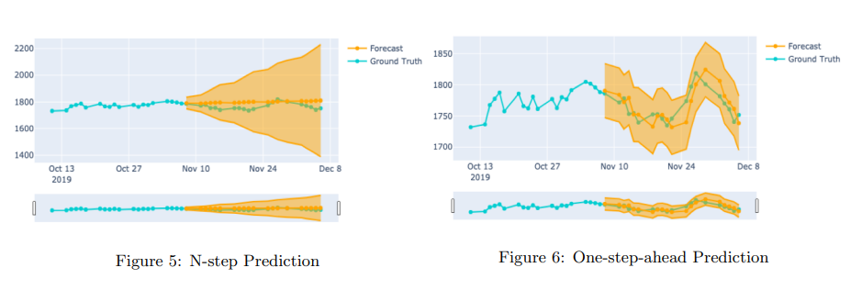

Slide 18
While both strategies model the series as a Gaussian state space model and use filtering, the difference is that in the earlier forecasting strategy stock prices for the next 20 days are forecasted only using the samples and training data (01/02/2014 - 11/07/2019).
However in a one-step-ahead strategy apart from the samples and training data, additional prices are sent up until the day that has to be forecasted. For instance, to get the forecast for November 15th, stock prices between 11/08/2019 and 11/14/2019 will also be used.

Slide 19
Conclusion
Using cumulative absolute one-step-ahead prediction error, the prediction accuracy from the two forecast strategies is compared.
As expected, the cumulative prediction error from the one-step-ahead prediction is lesser compared to the prediction errors using the N-step forecasting.

Slide 20
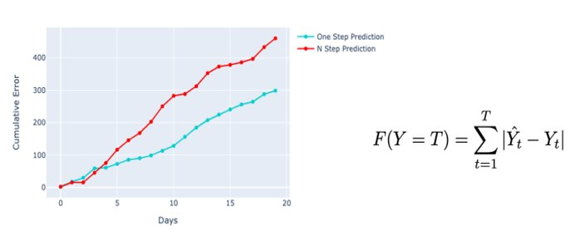

Slide 21
While the obtained estimates for the stock closing prices are relatively accurate, there are a few instances, wherein the price is forecasted to increase but there is a decrease in the stock price.
Knowing the relative change of the price is a very important factor in making investment decisions and hence the model forecasts should be improved further.

Slide 22
Possible approaches that can be undertaken are:
• Retraining the model everyday to accurately predict the stock prices for tomorrow.
• Using Moving Average component along with the AutoRegressive component will additionally include the effect of the previous residual noise on today’s price.
• Considering other features like price-earning (P/E) ratio in forecasting stock closing prices.

Slide 23
Thank You

